Slide 1


A VISUAL REPRESENTATION OF CONSOLE BASED FOODPANDA APP
WALEED BUTT -200900
HASSAN NAZIR -200912
MUHAMMAD IMRAN -200855

Slide 2
MAIN CONCEPTS
INHERITENCE
FILE HANDLING
DYNAMIC ALLOCATION

Slide 3
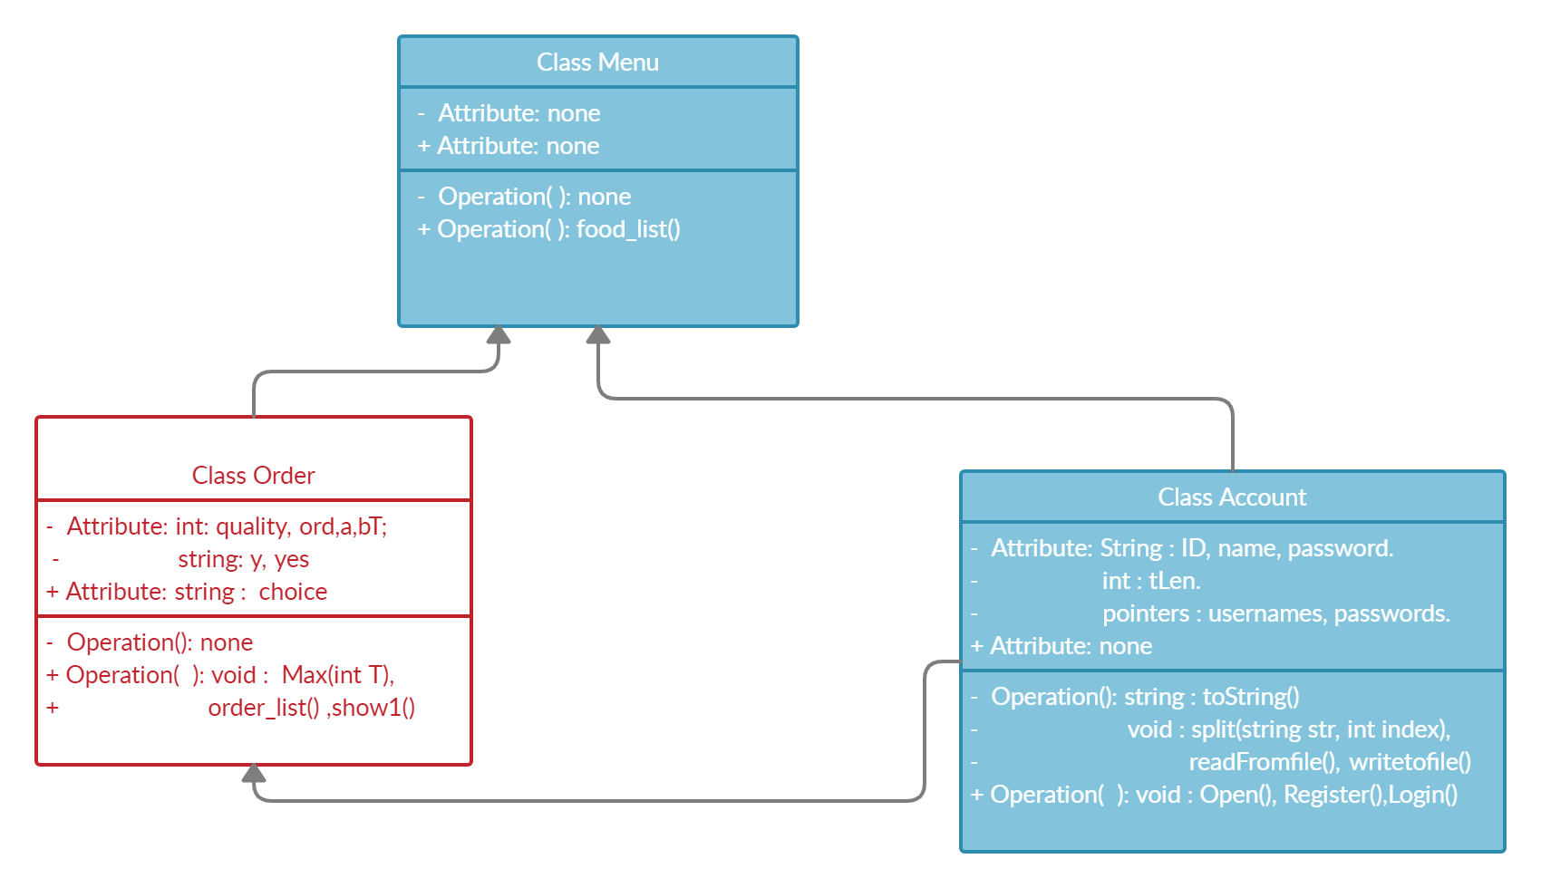
UML DIAGRAM OF PROJECT APP

Slide 4
CLASSES
Class
Class
Class
Account
Order
Menu

Slide 5
MENU CLASS
FUNCTION
PIZZA
FOOD LIST
BURGERS
SIDES

Slide 6
ORDER CLASS
FUNCTIONS
Selective options for Orders
Order Billing
Order type [D/P]

Slide 7
ACCOUNT CLASS
FUNCTIONS AND CONCEPTS
File Handling.
Dynamic Allocation
Functions:
Registration
Login
REGISTRATION
LOGIN

Slide 8
SIMPLE WALK THROUGH
REGISTRATION
LOGIN
ORDER
SELECTION
BILLING AND CHECKOUT

Slide 9
THANK YOU!

